Slide 1
CE101 Team Project Challenge
Anthony Vickers
October 2015
Team Report and the final countdown
Vishwanathan Mohan

Slide 2
Team Report – Essential Information
The team report is the main coursework assignment for CE101, carrying a module weighting of 50%.

Slide 3
Team Report – Essential Information
The team report is the main coursework assignment for CE101, carrying a module weighting of 50%.
During weeks 24/25 we Will have the product presentation and demos (we are in week 20 at the moment) – I will send a detailed email on that soon

Slide 4
Team Report – Essential Information
The team report is the main coursework assignment for CE101, carrying a module weighting of 50%.
During weeks 24/25 we Will have the product presentation and demos (we are in week 20 at the moment) – I will send a detailed email on that soon
Deadline for team report - march 26th (week 26- CHECK FASER)

Slide 5
Team Report – Essential Information
The team report is the main coursework assignment for CE101, carrying a module weighting of 50%.
During weeks 24/25 we Will have the product presentation and demos (we are in week 20 at the moment) – I will send a detailed email on that soon
Deadline for team report - march 26th (week 26- CHECK FASER)
VERY IMPORTANT
EVERY TEAM MEMBER MUST SUBMIT AN IDENTICAL COPY OF THE TEAM REPORT THROUGH FASER
No Submission- I/SUPERVISORS cannot mark it- leads to ‘ZERO’ in the system

Slide 6
Team Report – Essential Information
The team report is the main coursework assignment for CE101, carrying a module weighting of 50%.
During weeks 24/25 we Will have the product presentation and demos (we are in week 20 at the moment) – I will send a detailed email on that soon
Deadline for team report - march 26th (week 26- CHECK FASER)
VERY IMPORTANT
EVERY TEAM MEMBER MUST SUBMIT AN IDENTICAL COPY OF THE TEAM REPORT THROUGH FASER
No Submission- WE cannot mark it- leads to ‘0’ in the system
IF YOU SUBMIT LATE- PLEASE FOLLOW THE CORRECT PROCEDURE (late submission form), BUT TRY TO BE ON TIME!!!

Slide 7
Team Report – Essential Information
The team report is the main coursework assignment for CE101, carrying a module weighting of 50%.
During weeks 24/25 we Will have the product presentation and demos (we are in week 20 at the moment) – I will send a detailed email on that soon
Deadline for team report - march 26th (week 26- CHECK FASER)
VERY IMPORTANT (there is no reassessment option for team work)
EVERY TEAM MEMBER MUST SUBMIT AN IDENTICAL COPY OF THE TEAM REPORT THROUGH FASER
No Submission- WE cannot mark it- leads to ‘0’ in the system
IF YOU SUBMIT LATE- PLEASE FOLLOW THE CORRECT PROCEDURE (late submission form), BUT TRY TO BE ON TIME!!!

Slide 8
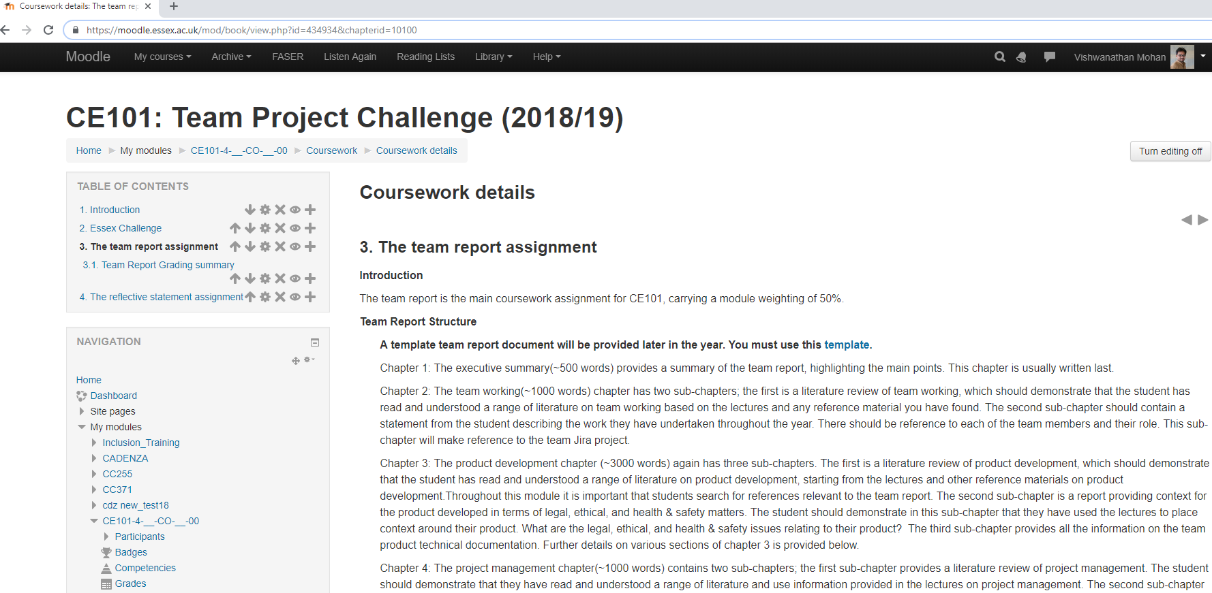
Team Report – Where to find further details

Slide 9
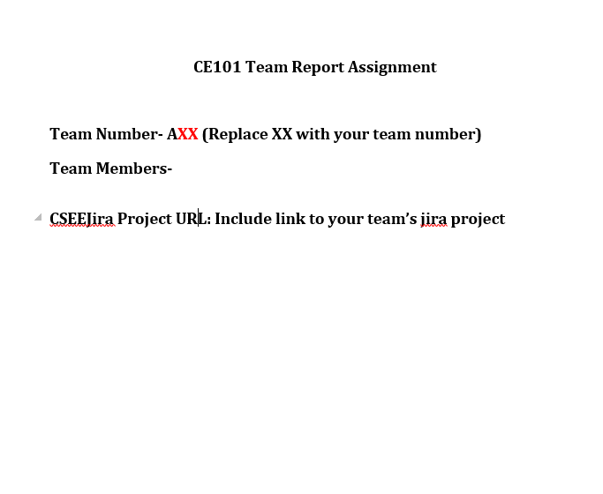
https://cseejira.essex.ac.uk/projects/CE101T49/summary
Write the full names (and not - UDO, LEO, AL, Josh, Josh, Penny, Vishuu)
VISHWANATHAN MOHAN

Slide 10
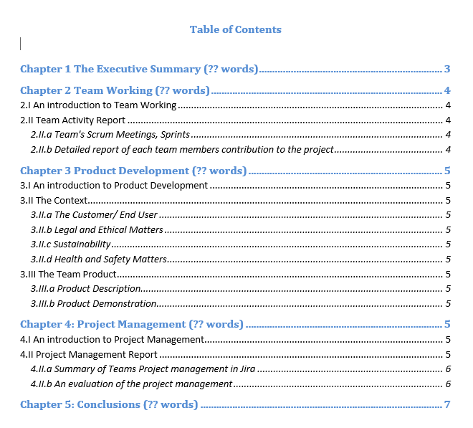
I will quickly go through each of these sections, some Do’s/ Donts

Slide 11
GENERAL INSTRUCTIONS
Follow the template
Cover all sections/subsections
There is some flexibility in the word count (but don’t make it too long, It should be evidence based)
Bad writing can many times kill good ideas/good work/projects, good writing can
some times save a doomed project
Team as a whole must take responsibility for the report

Slide 12
What, Why, Why Now, Any Highlights (500 words)
Usually written at the end….

Slide 14
I will quickly go through each of these sections, some Do’s/Donts
literature review of team working- based on the lecture notes (Unit 2 and UNIT 1 in MOODLE)
https://moodle.essex.ac.uk/course/view.php?id=12424&section=7

Slide 15
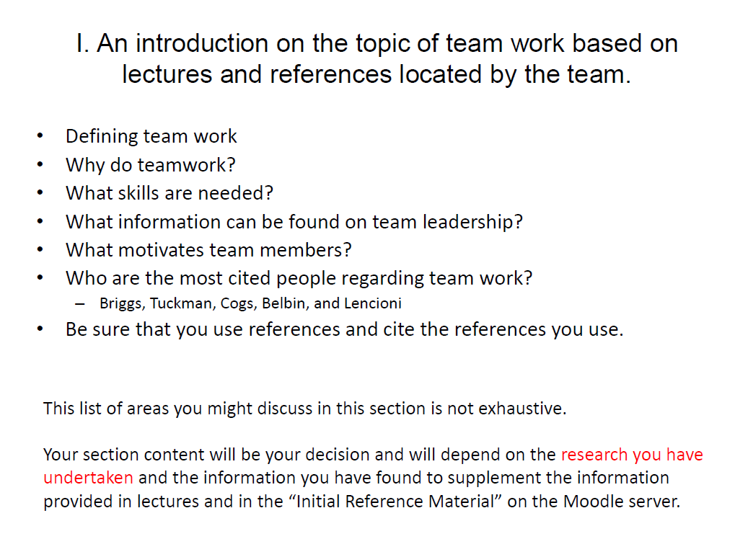

Slide 16
I will quickly go through each of these sections, some Do’s/Donts
literature review of team working- based on the lecture notes (Unit 2 and UNIT 1 in MOODLE)
https://moodle.essex.ac.uk/course/view.php?id=12424&section=7
Remember that multiple choice questions in the CE101 Examination are based on the lecture notes (so it might be worthwhile to go though it)

Slide 17
I will quickly go through each of these sections, some Do’s/Donts

Slide 18
I will quickly go through each of these sections, some Do’s/Donts
Use snapshots from your team area in jira to evidence the teams activity
Snapshot of your product backlog
Number of issues created (picture), Sprints, Scrum meetings held
Include a paragraph or two on how the group worked together, your reflection on what you could have done better (next time..)
Team members can agree on the details..
JIRA Example

Slide 19
I will quickly go through each of these sections, some Do’s/Donts
EACH TEAM MEMBER PROIVEDS 200 WORDS RELATED TO THEIR CONTRIBUTION
USE AN AGREED STRUCTURE TO HAVE CONSISTENCY
EVIDENCE IT (USE JIRA)
Try avoiding a blame or name and shame culture
It is important to understand that a team succeeds in some ways and fails in others.
Try to draw out strengths but admit to weaknesses and show that the weaknesses have been professionally evaluated and lessons learnt.
DON’T OVERHYPE

Slide 20
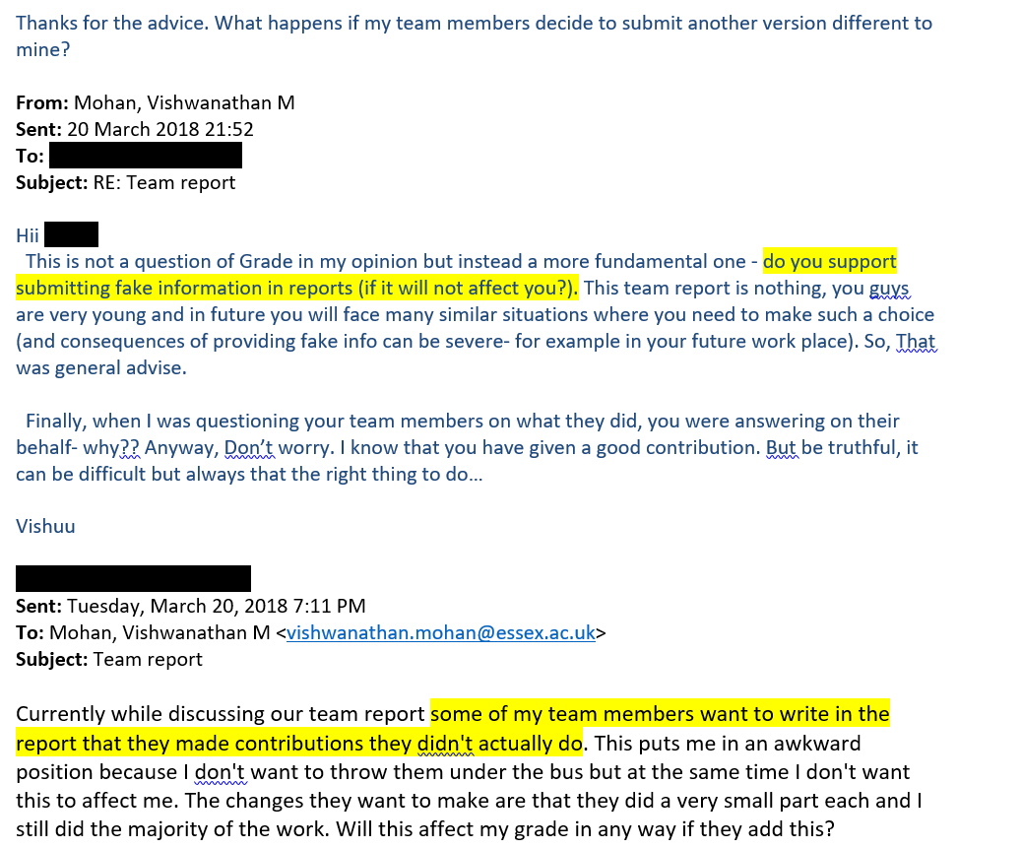
DON’T OVERHYPE – Its not a good practice (sometimes YOU can be in an awkward position)

Slide 23
Summary OF CHAPTER 2
Literature review of team working
Team activity (with reference to JIRA)
Individual contribution 200 words (EVERY ONE AGREES- HAVE A TEAM MEETING)

Slide 24
Chapter 3
Almost follows the same structure like chapter 2
3.1 Literature review related to product development (UNIT 3, Unit 4)
REMEMBER THAT MCQ QUESTIONS IN EXAM WILL BE FROM THESE NOTES

Slide 25
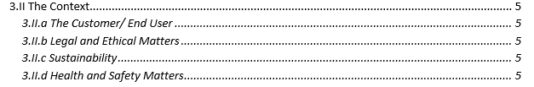
CONTEXT DEPENDS ON WHICH PROJECT YOUR TEAM IS DOING
Example- Strawberry picking robots

Slide 26
CONTEXT DEPENDS ON WHICH PROJECT YOUR TEAM IS DOING
Customer / end user – why Are you doing this project
how can your project be useful

Slide 27
CONTEXT DEPENDS ON WHICH PROJECT YOUR TEAM IS DOING
Customer / end user – why Are you doing this project
how can your project be useful
Example- Strawberry picking robots
Labour Shortage- Critical shortage of workers for ‘repetitive, laborious and less rewarding’ tasks (Approximately 20% of UK soft-fruit unpicked in 2017- AHDB)
INCREASING DEMAND Berries now make up 22% of all fruit sold in the UK with prediction to reach almost £2bn by 2020 (Kantar report).
Supermarkets are adopting an increased reliance on Imports (affecting local/ Pan UK businesses)
FRUIT PICKING/PACKING IS 1/3RD OF THE PRODUCTION COST
PESTICIDE FREE FARMING- SUSTAINABILITY, 24/7 OPERATION
Problem not confined to UK- worldwide problem
A TECHNOLOGICAL SOLUTION WILL CHANGE THE AGRIFOOD INDSUTRY

Slide 28
CONTEXT DEPENDS ON WHICH PROJECT YOUR TEAM IS ARE DOING
Customer / end user – why Are you doing this project
how can your project be useful
Your Project ?
LOVELACE- HOUSE PRICE PREDICTION ????????
BELLS- EVERY TEAM HAS A DIFFFERENT PROJECT (AIRPORT ASSITANT, HEALTHCARE ROBOT, TIMETABLE BOT, RESTAURANT HELPER, RECEPTIONIST, UR3 PICKNpLACE, CHESS PLAYER….)
FARADAY- AUTONOMOUS NAVIGATION WITH EMORO ROBOT –
WHERE CAN SUCH SYSTEMS BE USED ??
USE YOUR IMAGINATION AND CREATIVITY- THINK BIG

Slide 29
CONTEXT DEPENDS ON WHICH PROJECT YOUR TEAM IS ARE DOING
Customer / end user – why Are you doing this project
how can your project be useful
Your Project
Health and Safety, legal and ethical matters – dependent on your specific project
Basic Information- UNIT 4 OF MOODLE
https://moodle.essex.ac.uk/mod/book/view.php?id=434973
TEAMS Can use THEIR imagination (and think at broader aspects)
PRIVACY, CYBERCRIME, ETHICAL RESPONSIBILITY, DAMAGE TO ENVIRONMENT…..
You must have a clear understanding of the context

Slide 30

Include the following-
Overall description (what does it do)
Interfaces (Input / output / subsystems)
What methods did you use to arrive at your solution
Describe how you achieved your implementation
Any highlights, things that make the product impressive (LOVELACE- RANK IN kAGGLE)
What are the limitations, scope for improvement
KEEP THE TEXT BRIEF AND TO THE POINT
USE PICTURES (BLOCK DIAGRAMS, SNAPSHOTS )

Slide 31
DESCRIBE WHAT KIND OF TESTS WERE DESIGNED AND PERFORMED
INCLUDE SCREENSHOTS OF VARIOUS PHASES OF PRODUCT WORKING
LINK CONSECUTIVE SCREENSHOTS TOGETHER WITH A SHORT DESCRIPTION TO BUILD UP A SHORT NARRATIVE
Imagine A PERSON WHO NOT SEEN YOUR DEMO- Think how can s/he CAN GET AN IDEA OF WHAT IT DOES, BE CREATIVE!!

Slide 32
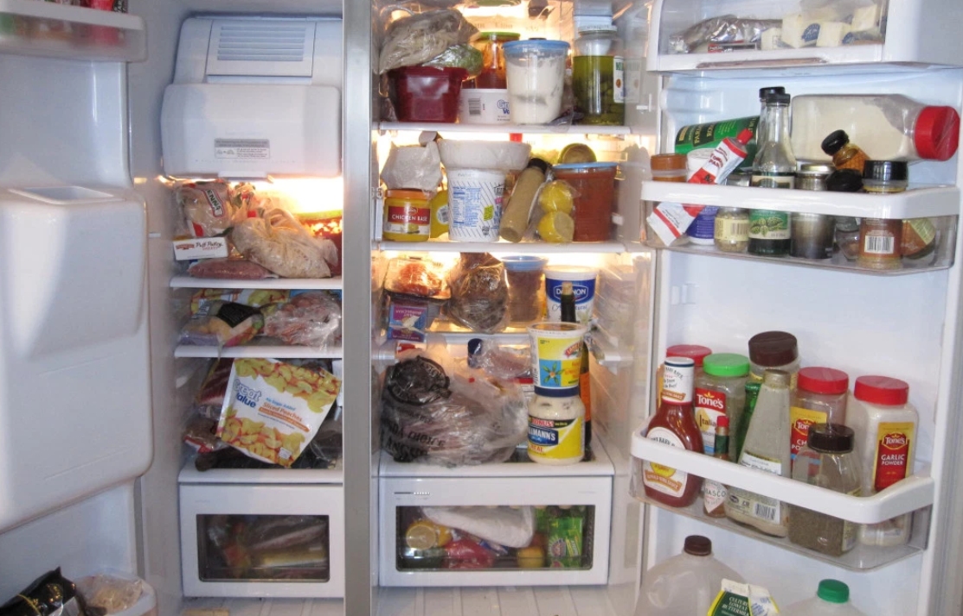
STRAWBERYY PICKING ROBOTS The challenge
Notes:
The sequcne of actions I need to take- 5 mins

Slide 33
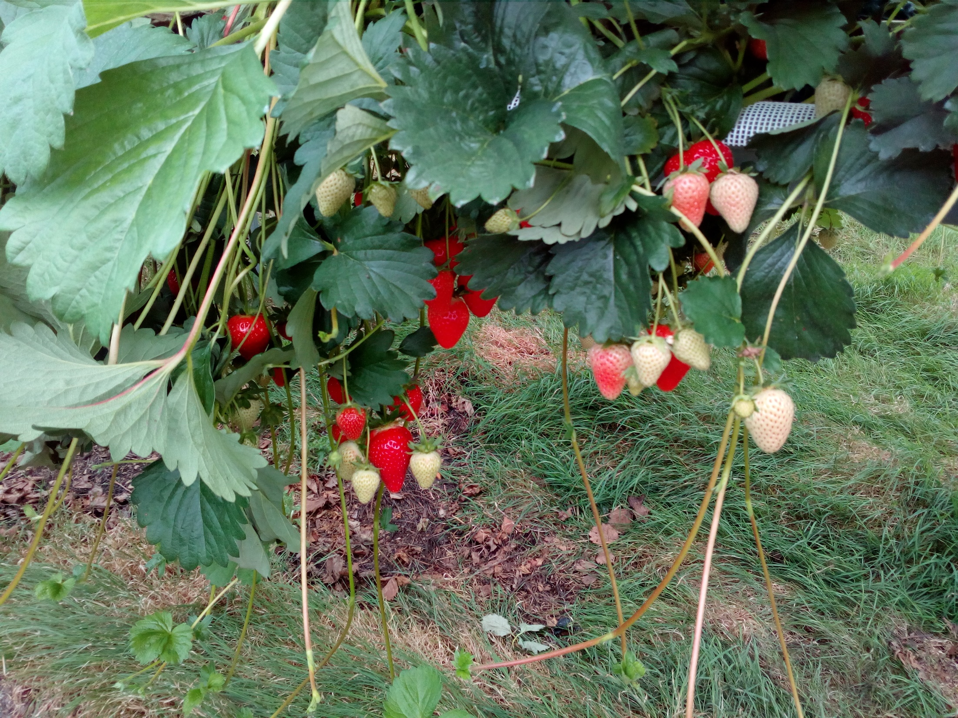
A task where humans are very good and robots are very bad
Notes:
Bit on Action system we are using ,
these are the easier ones…
Human brain has a fraction of a second-is it ready to pick, how ripe it is, is it disease free, which one to pick

Slide 34
DESCRIBE WHAT KIND OF TESTS WERE DESIGNED AND PERFORMED
INCLUDE SCREENSHOTS OF VARIOUS PHASES OF PRODUCT WORKING
LINK CONSECUTIVE SCREENSHOTS TOGETHER WITH A SHORT DESCRIPTION TO BUILD UP A SHORT NARRATIVE
Imagine A PERSON WHO NOT SEEN YOUR DEMO- Think how can s/he CAN GET AN IDEA OF WHAT IT DOES, BE CREATIVE!!
We want to minimize too much text
DURING THE LABS SESSIONS PLEASE ASK/discuss your ideas with YOUR SUPERVISORS IF YOU NEED INFORMATION (as some of this information is specific to the particular project)
Send me an email (WE WANT YOU TO LEARN TO WRITE HIGH QUALITY REPORTS)

Slide 35
Chapter 3 summary
Literature review
Project context
Project description
Testing

Slide 36
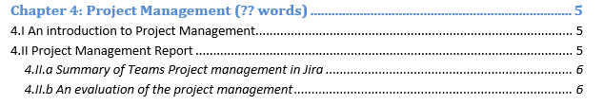
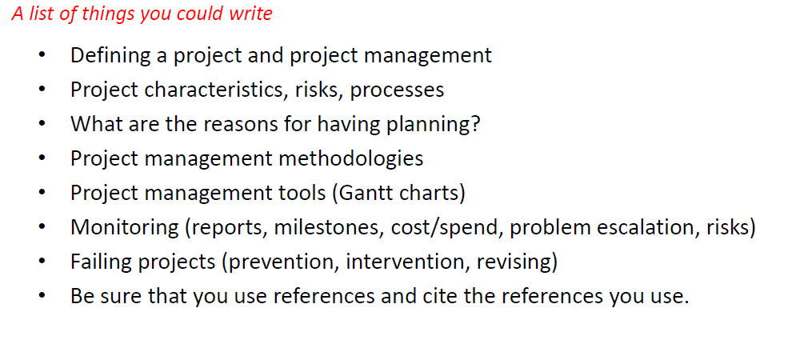
4.1 Literature survey on project management based on lecture notes (MCQ in exams..)

Slide 37
USE SCREENSHOTS OF VARIOUS REPORTS IN JIRA AS AN EVIDENCE TO DEMOSNTRATE USE OF MANAGEMENT TOOLS
- Cumulative flow diagram (status of issues over time)
- Burn down chart
- VELOCITY CHART

Slide 38
USE SCREENSHOTS OF VARIOUS REPORTS IN JIRA AS AN EVIDENCE TO DEMOSNTRATE USE OF MANAGEMENT TOOLS
- Cumulative flow diagram
- Burn down chart
- VELOCITY CHART
ATLEAST SHOW SCREENSHOTS RELATED TO LAST TWO SPRINTS (FROM NOW ON), Jira does all this for you

Slide 39
USE SCREENSHOTS OF VARIOUS REPORTS IN JIRA AS AN EVIDENCE TO DEMOSNTRATE USE OF MANAGEMENT TOOLS
- Cumulative flow diagram
- Burn down chart
- VELOCITY CHART
ATLEAST SHOW SCREENSHOTS RELATED TO LAST TWO SPRINTS (FROM NOW ON), Jira does all this for you
Evaluation of the project management-
short summary of the team project management, what went well, things to improve…
Agreed by all team members

Slide 41
SUMMARY
Deadline for team report - march 26th (CHECK FASER)
EVERY TEAM MEMBER MUST SUBMIT AN IDENTICAL COPY OF THE TEAM REPORT THROUGH FASER
During weeks 24/25 we Will have the product presentation and demos (we are in week 20 at the moment)
REFER TO THE LECTURE NOTES IN VARIOUS UNITS (ALSO USEFUL FOR EXAMS)
DRAW UPON EVIDENCE – SNAPSHOTS OF RESULTS OF THE WORKING PRODUCT, TEAM ACTIVITY IN JIRA
IF YOU HAVE A DRAFT READY BY WEEK 23 SUPERVISORS CAN GIVE FEEDBACK DURING THE LAB SESSION

Slide 42
CHECK WITH THE SUPERVISORS IF YOU HAVE ANY QUERY (EMAIL ME)
LOVELACE- HAIDER RAZA
BELL- ME
FARADAY- DAVID/ME
Slides are up in Moodle…
Only one month- so focus on getting the work done

